Slide 1

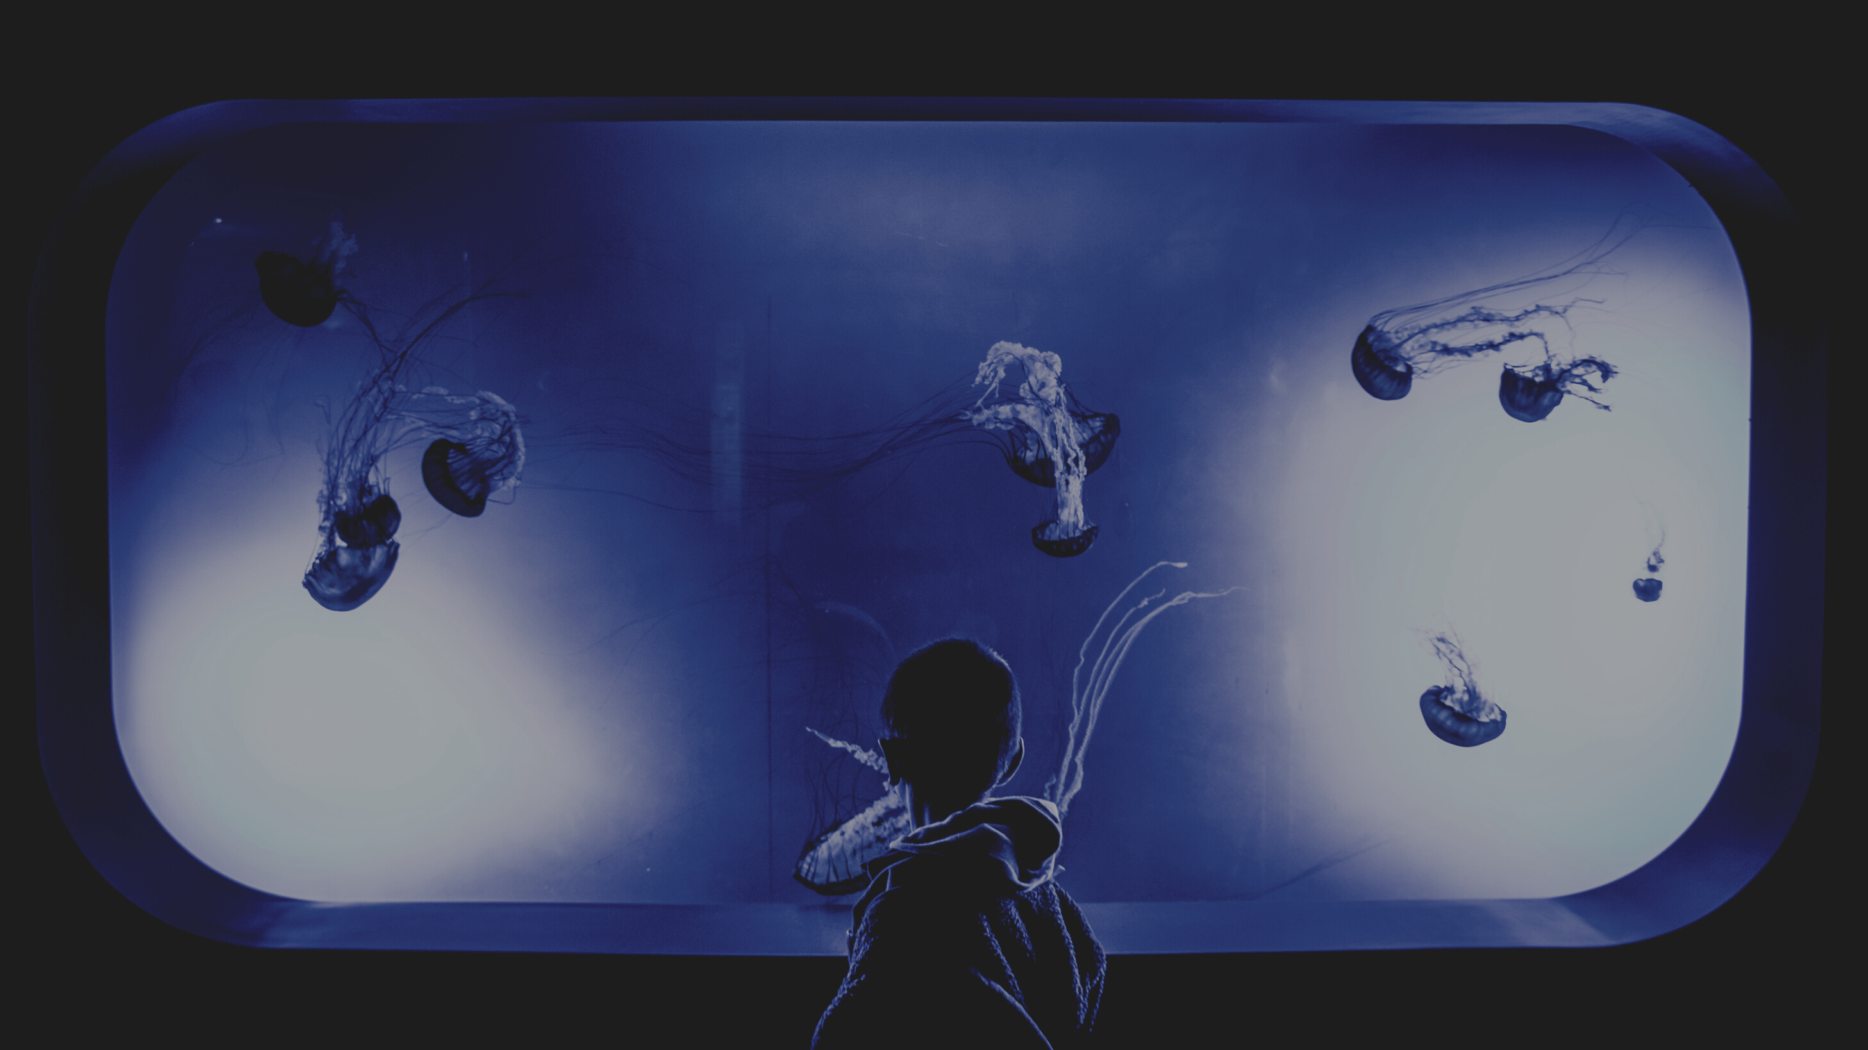

IoT Based Smart Aquarium
by Group 8 (IoTians)
Group Members :-
Aryan Kumar - 190185
Naveen Kumar Mathur - 190535
Amit Kumar Singh - 190117
Prince Kumar Ahirwar - 190646
Aman Raw - 190108
Supervisor: Dr. Priyanka Bagade
Mentors: Rahul Kumar, Ravi Shankar Das

Slide 2

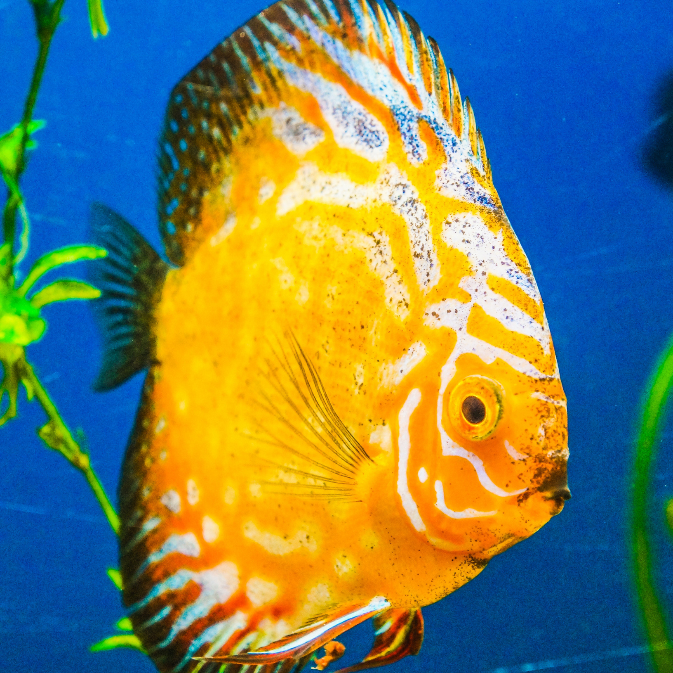

Introduction
IoT Based Smart Aquarium :
Through this project, we will monitor water quality and environment of an aquarium.
pH level measurements will help us monitor and regulate the water quality. Whereas, the brightness readings (crucial for fish's health) will help us in timely lumination of the tank.

Slide 3
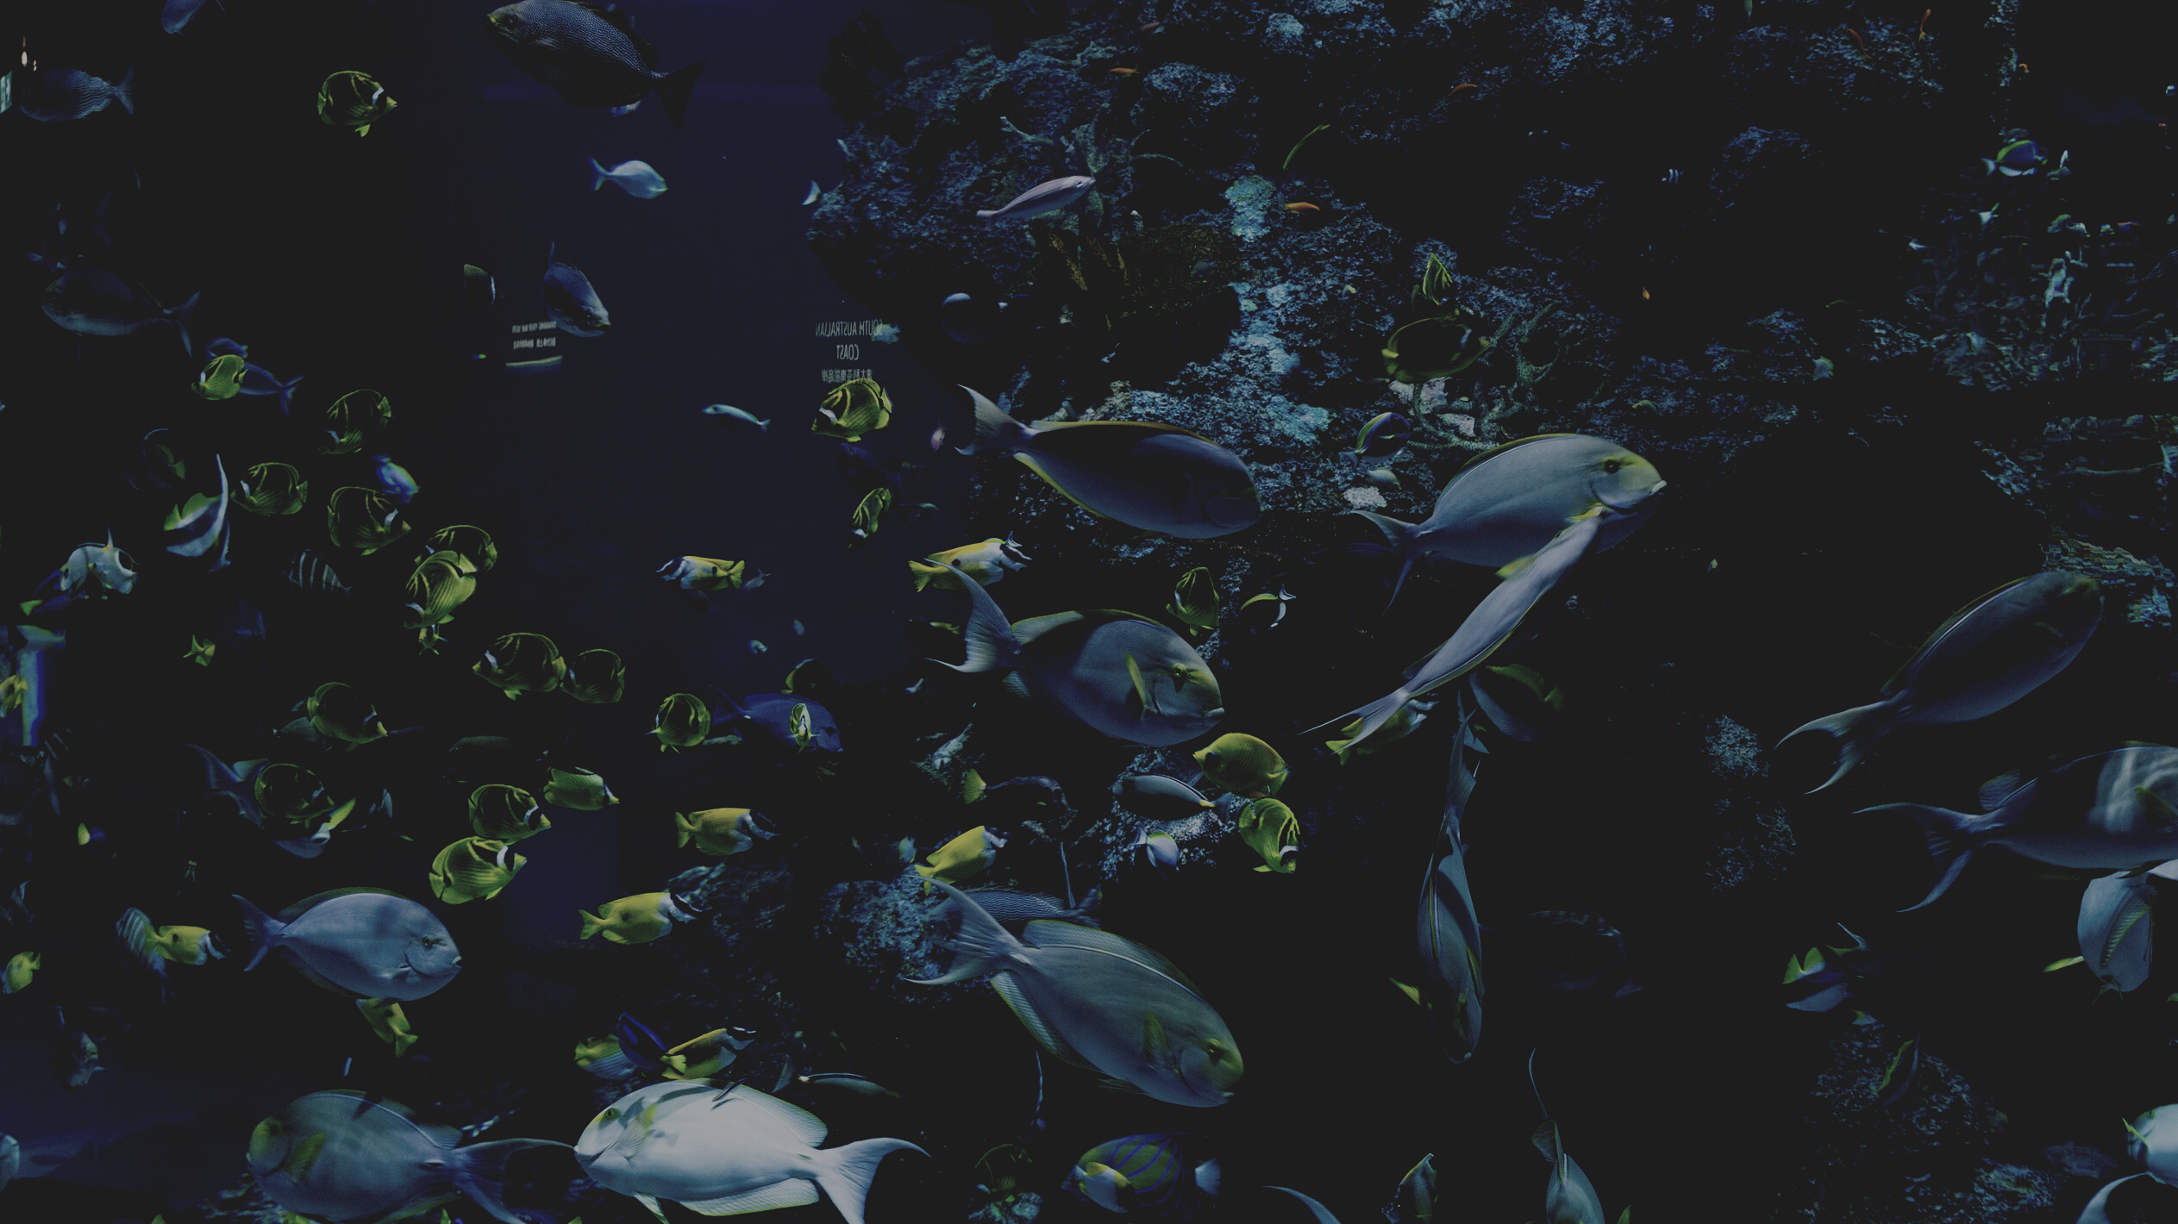

Problem Statement
- Many people keep fish as pets as it can provide decoration for a home and watching them can help people relax.
- Poor water and surrounding quality can be harmful for the fish, hence water needs to be periodically changed. It is not generally possible to know whether their aquarium is experiencing an abnormal situation.
Problem Statement: To build a simple and productive technique to examine water quality with ease, low control and user friendly and make the water quatity status available effortlessly to the client.

Slide 4

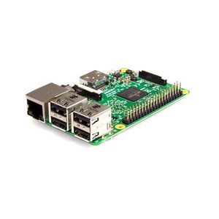
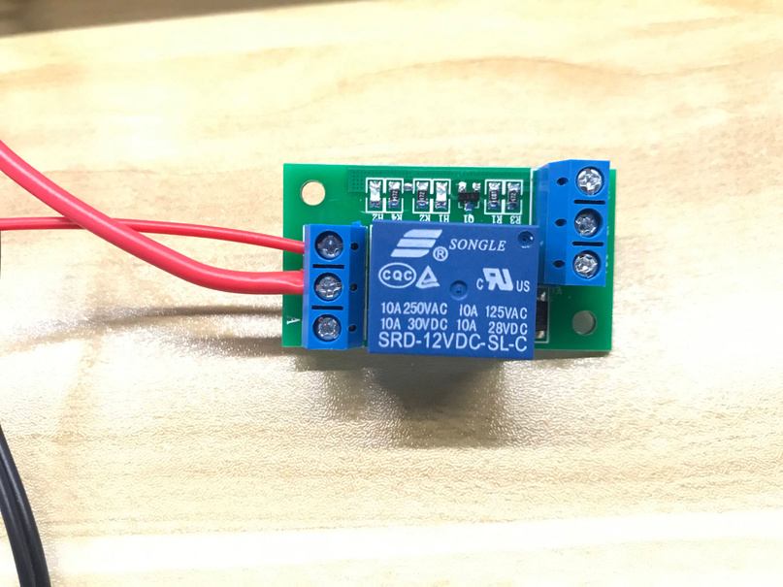
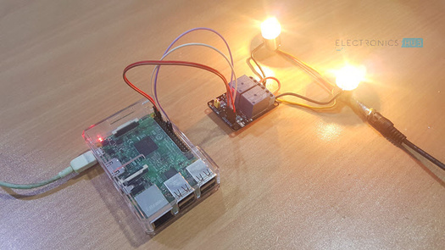
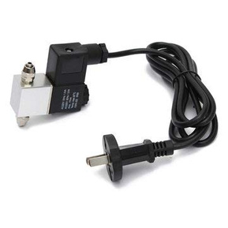
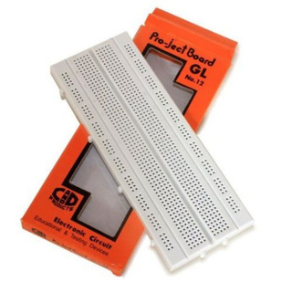
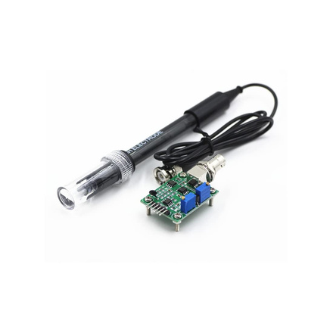

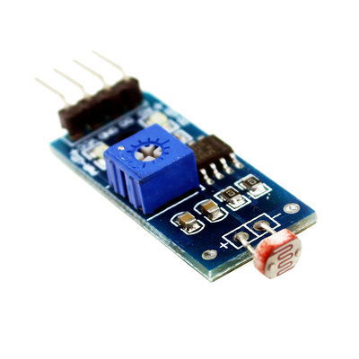
Equipments Used
Relay
Light
Raspberry Pi 3
Breadboard
and
Wires
pH Sensor
Arduino
LDR Sensor
Solenoid Valve

Slide 5




Tasks
We used sensors
(LDR, pH sensor) to the collect data. LDR sensor in the mobile phone connected to Raspberry Pi through Flask-Socket and pH sensor connected to the Arduino.
Then, we connected the Arduino board to the Raspberry Pi. All the connection with LEDs and Solenoid Valve were also made. We then worked on codes.
Further, we worked on establishing a communication where Raspberry Pi acted as a server and our PC acted as a client over a local IP address on a chosen port

Slide 6


Tasks
Used methods present in socket library in python, to establish the connection between Raspberry pi as server and other pc as client.
Thus, stream type communication (TCP) was achieved. We then worked on the endpoint webpage's backend and frontend.
We worked on the encryption and decryption of the data. Finally, we ran and tested our final project.

Slide 7
Overview of our
Project
Raspberry Pi Connections
Arduino Board Connections
LDR Sensor and its Conncetions
pH Sensor and its Conncetions
Arduino to Raspberry Pi Board Conncetion
Communication through Socket Programming
Requesting and receiving data through Webpage
Encryption and Decryption

Slide 8
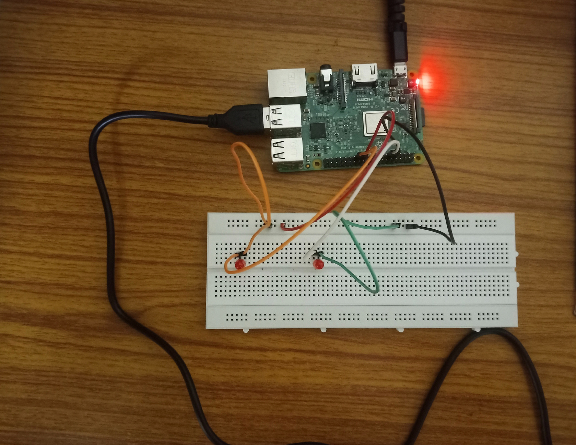
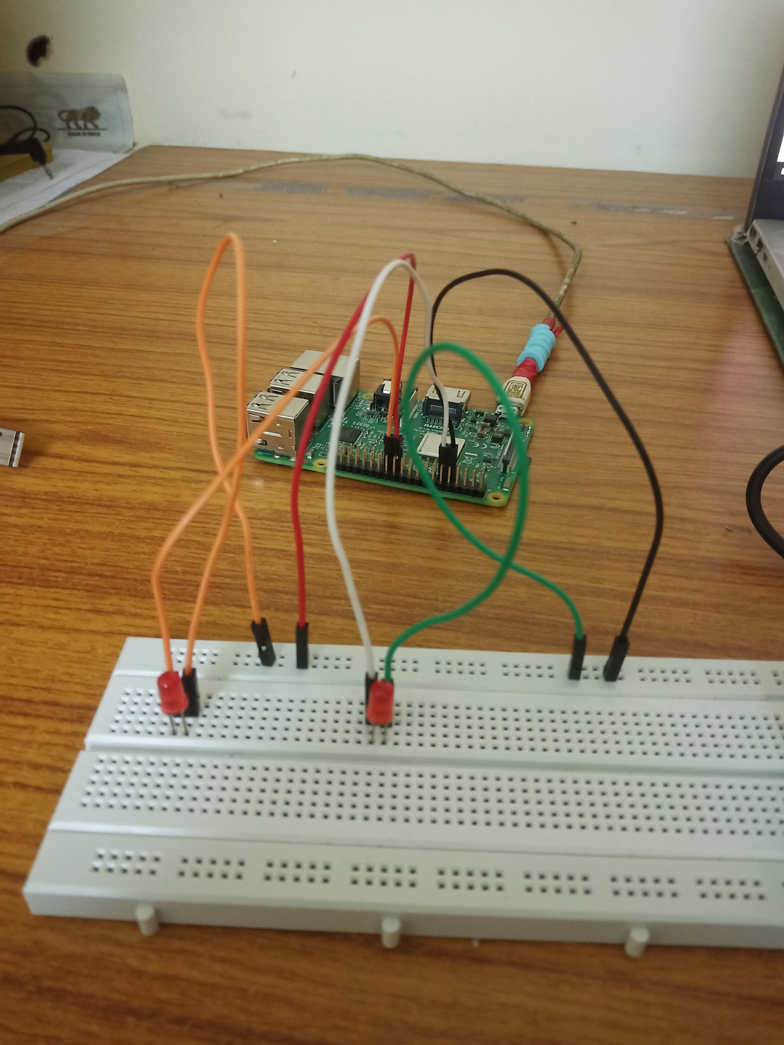
Components connected to
Raspberry Pi Board
Raspberry Pi
USB connecting Arduino
to Raspberry Pi
LED connection
on Bread Board

Slide 9
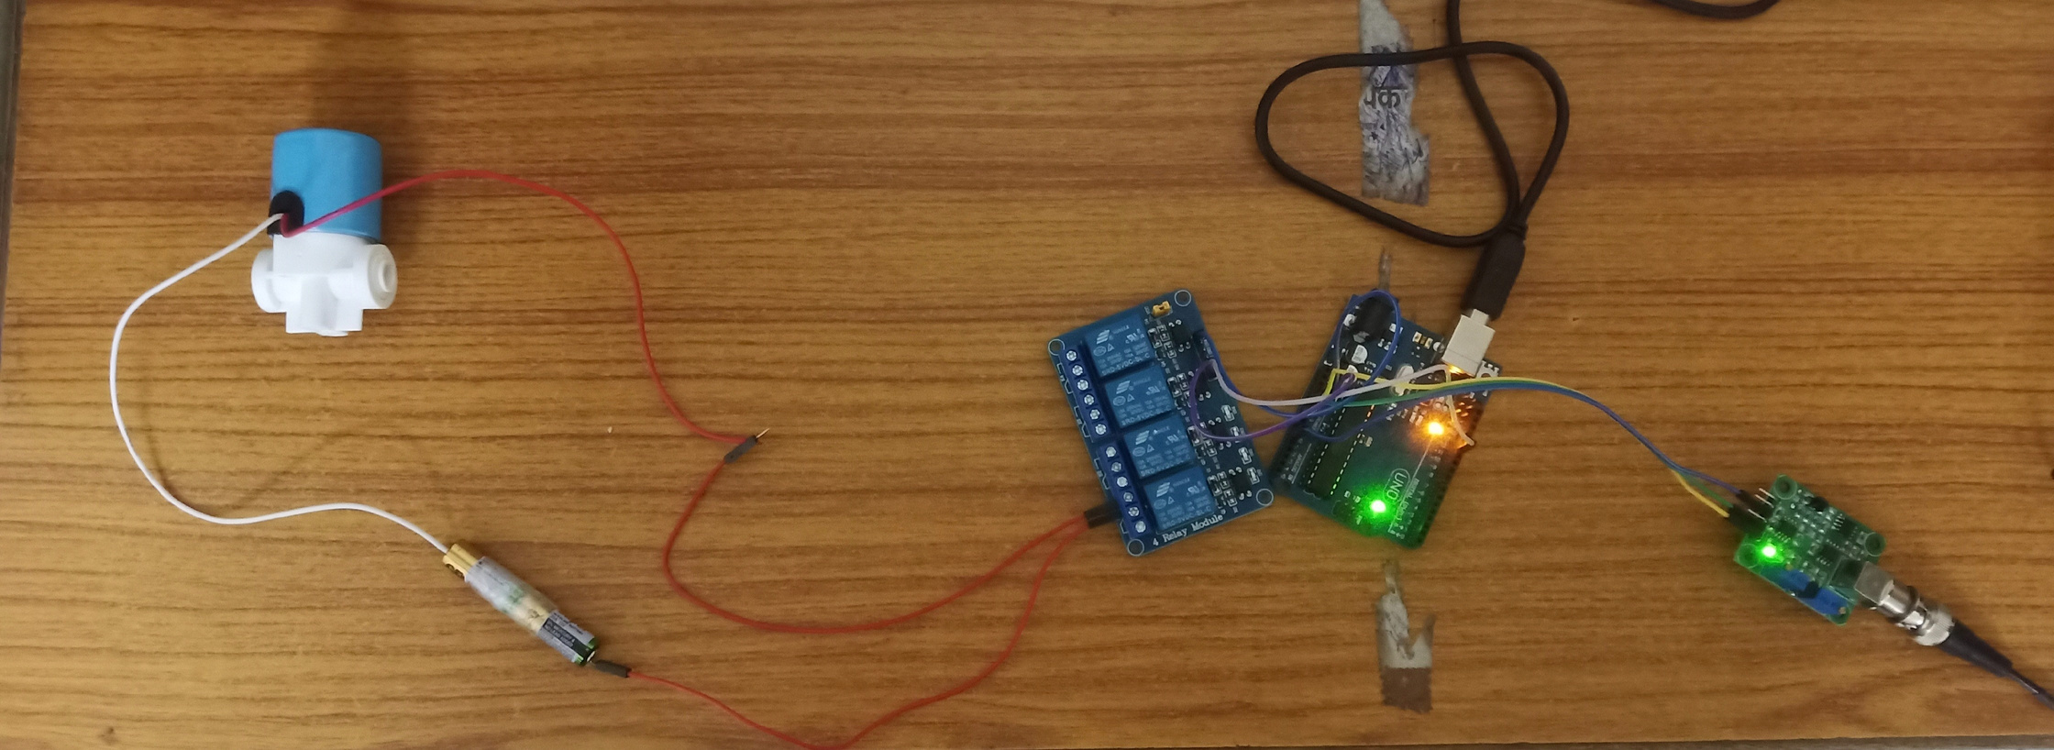
Components connected to
Arduino Board
Solenoid Valve
USB connecting Arduino
to Raspberry Pi
Relay
pH Sensor
Arduino
Battery

Slide 10

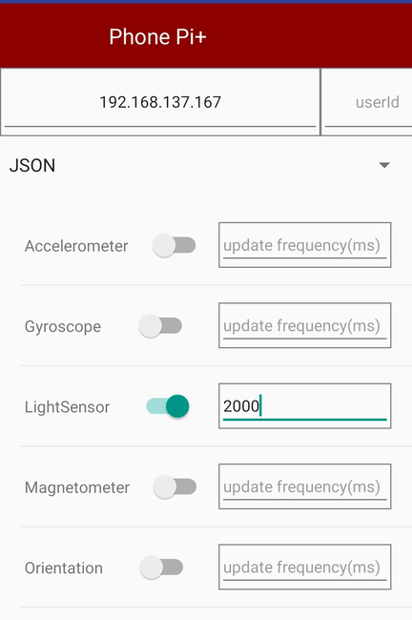
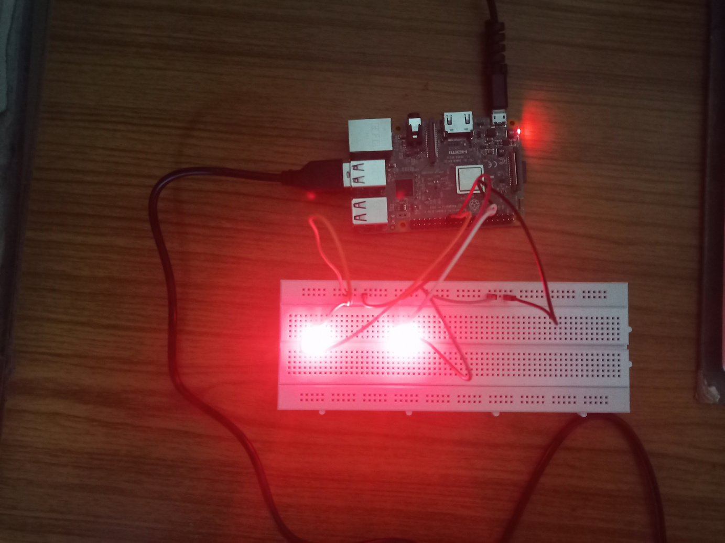
LDR Sensor & its Connections
Used Light Sensor present in the Smart Phone for the project.
We used PhonePI+ mobile app (https://play.google.com/store/apps/details?id=com.phonepiplus&hl=en_US&gl=US&pli=1) for streaming light values to Raspberry Pi through Flask-Socket communication.
We connected 2 LEDs with Raspberry Pi which automatically handle non-ideal light conditions in the aquarium surroundings.
The 2 LEDs are connected to GPIO 17 (pin number 11) and GPIO 11 (pin number 23) of the Ras Pi
In a room, light values can vary between 0-100 lux (Illuminance). LEDs will turn ON for light values between 0-20 and turn OFF for more than 40.

Slide 11
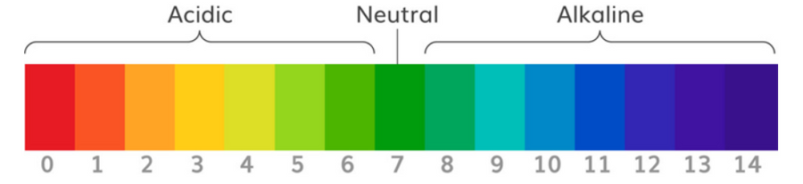

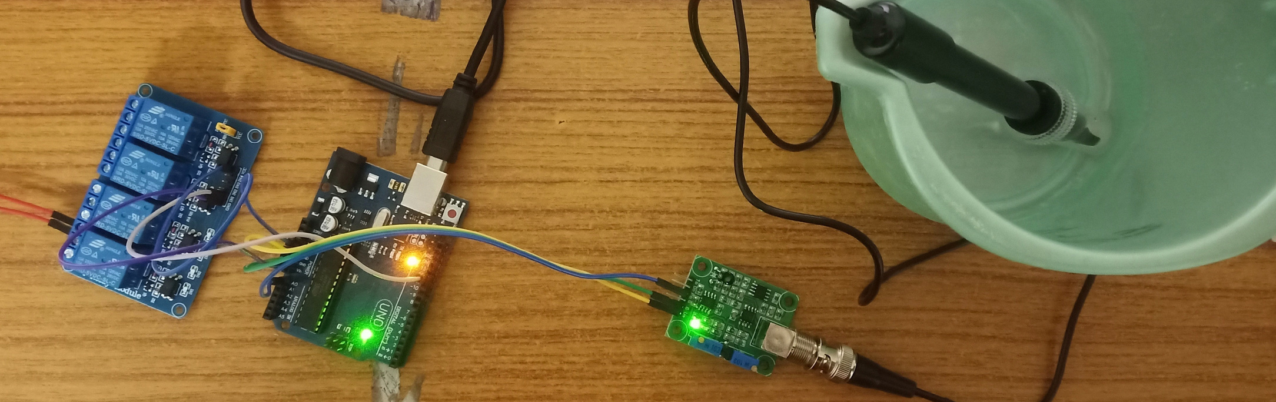
pH Sensor & its Connections
Solenoid Valve
Battery
Relay
PH electrode
pH Signal Conversion Board
Arduino Board

Slide 12
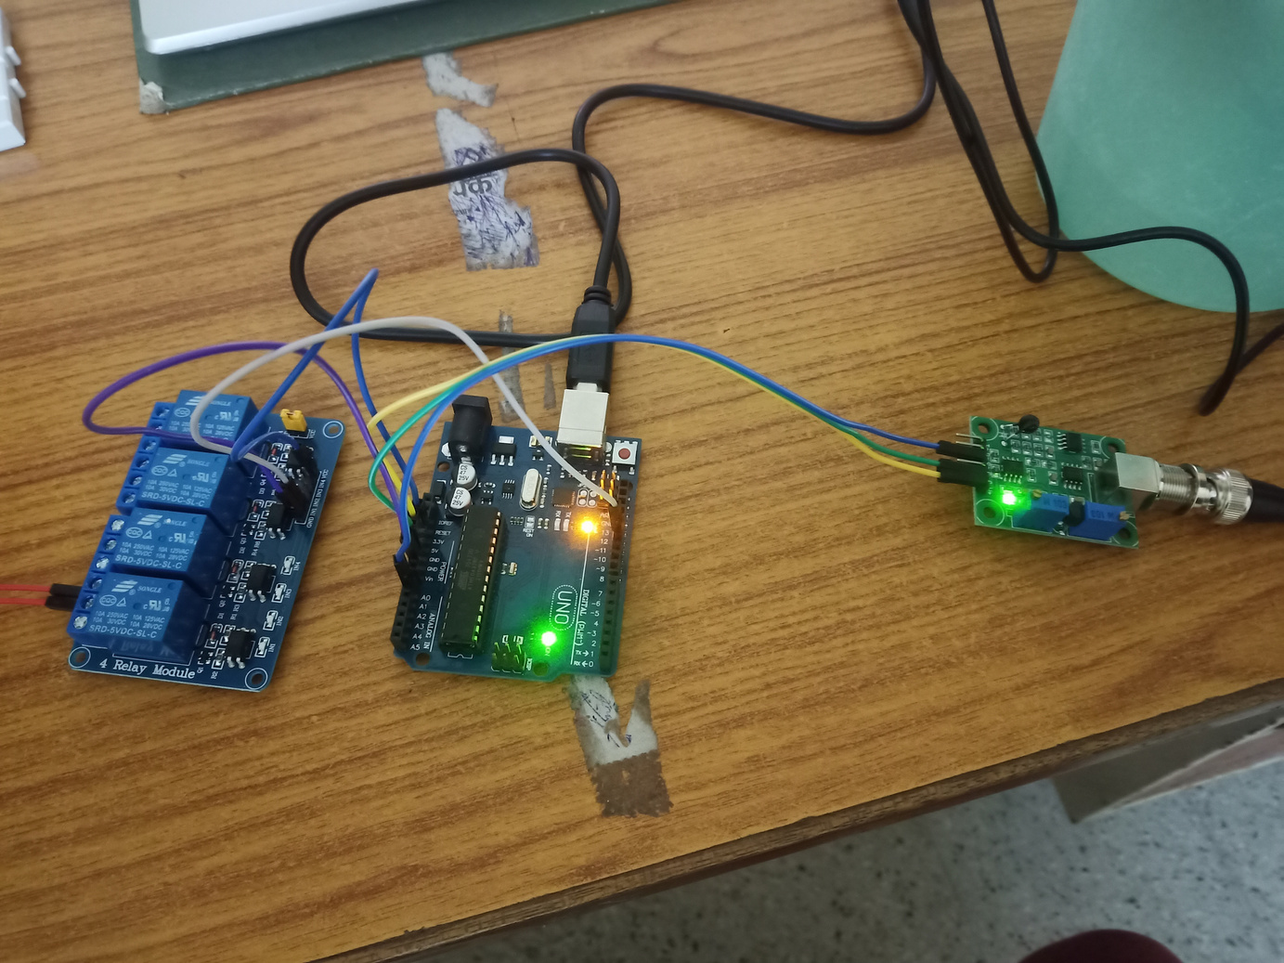
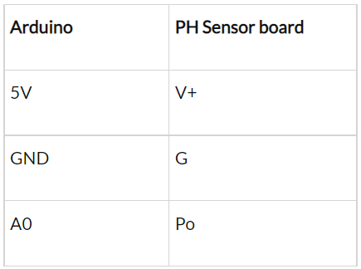
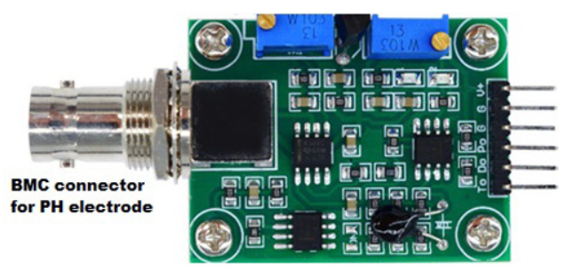
pH Sensor & its Connections
Analog pH sensor is used to measure the pH value of the aquarium water and show the acidity or alkalinity of the water.
The Nernst equation gives a relation between the cell potential of an electrochemical cell, temperature, reaction quotient and the standard cell potential. This equation is used to calculate the PH value of a solution as well. The glass electrode response is governed by the Nernst Equation can be given as:
E = E0 - 2.3 (RT/nF) ln Q
Where: Q= Reaction coefficient, E = mV output from the electrode
E0 = Zero offset for the electrode, R = Ideal gas constant= 8.314 J/mol-K, T = Temperature in ºK, F = Faraday constant = 95,484.56 C/mol, N = Ionic Charge
We connected the pH sensor to the conversion board which was then connected to the Arduino board to program it and get the readings.
pH Signal Conversion Board

Slide 13
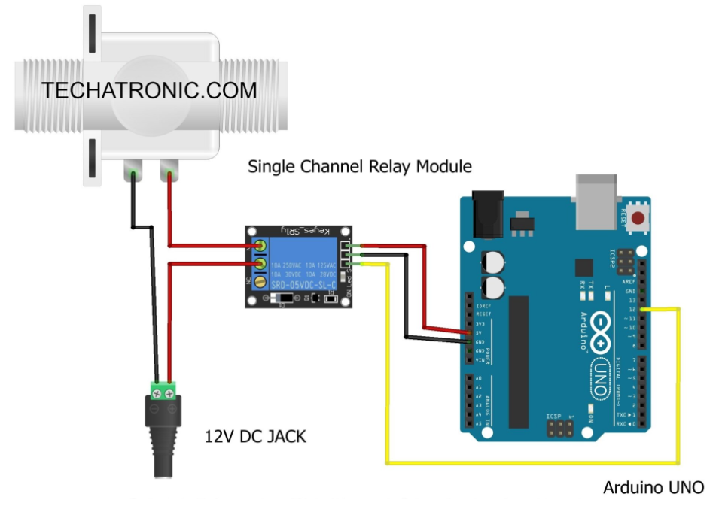
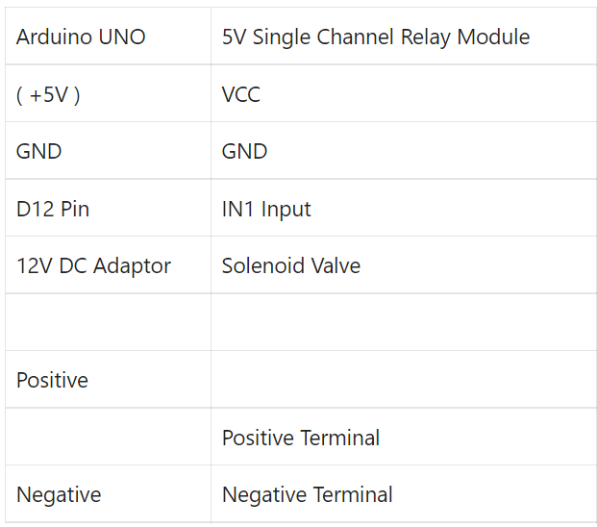
We attempt to regulate the pH of the aquarium water by adding or removing the water from it, until we achieve the suitable pH range. Here, we used solenoid valve which is used for controlling the flow of any liquid.
pH Sensor & its Connections
For this, we connected the solenoid valve with the Arduino board on with pH sensor is already connected. Relay act as the middleman between the valve and the board. The connections are as follows:
For non-ideal case: (pH>8 or pH<6.5), relay will automatically turn ON the solenoid valve for 2 seconds.
Solenoid Valve
/( +3.3V )
Battery

Slide 14
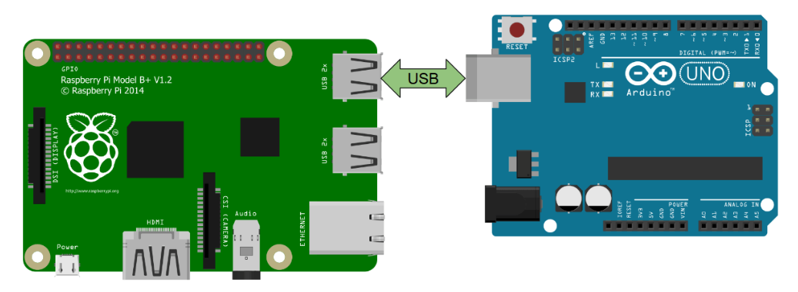
Arduino to Raspberry Pi Communication
We used Raspberry Pi and Arduino Board in our project and we connected them with each other through Serial communication.
On the Raspberry Pi side, we chose one of the 4 USB ports available on the board. For Arduino, we used the USB port that we used to upload code from your computer (with the Arduino IDE) to our board.
We first, connect your Arduino to our computer, so that we can upload the code into the board. After that, we connected the USB cable to the Raspberry Pi. The Raspberry Pi will power the Arduino via this cable.

Slide 15
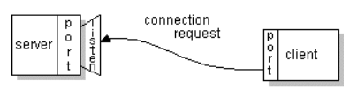
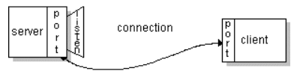
Communication through
Socket Programming
Socket programming is a way of connecting two nodes on a network to communicate with each other.
One socket(node) listens on a particular port at an IP, while the other socket reaches out to the other to form a connection. The server forms the listener socket while the client reaches out to the server.
Thes sockets work on two parameters. The first parameter refers to the address-family ipv4. and the other means connection-oriented TCP protocol. TCP is a connection-oriented protocol, which means a connection is established and maintained until the applications at each end have finished exchanging messages.

Slide 16
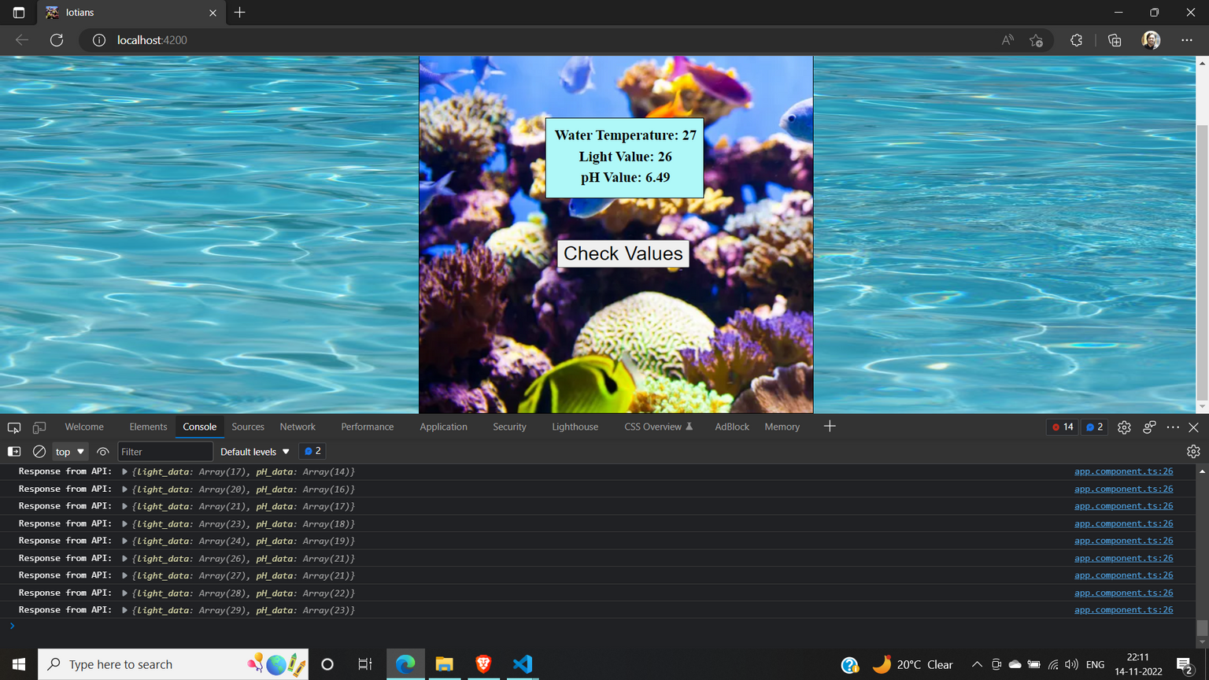
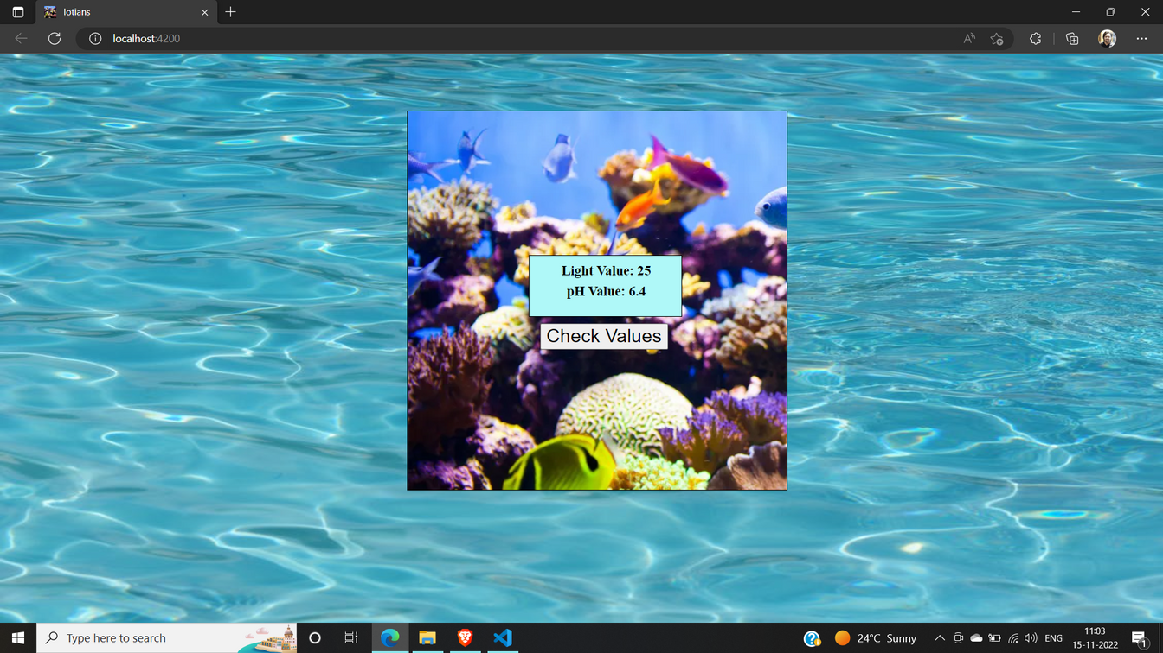
Requesting & Receiving data through
Webpage
Backend (Node js): Created an API to fetch real-time sensors data from a local JSON file
Frontend (Angular): Integrated the API to receive and display real-time sensor values on a button click

Slide 17


Sniffing network communication
• Anyone can listen to unencrypted messages using simple tools such as Wireshark
• For multicast messaging services such as CoAP, anybody within the range of the Time to live (TTL) parameter (maximum number of router hops) can eavesdrop
• For point-to-point communication, the communication can be heard by any application on the sending machine, the receiving machine, or any of the bridges or routers in between.
Solutions
• WE ENCRYPTED THE SENSOR DATA BEFORE TRANSMISSION
• For the smart home, a malicious entity can if someone is home or not by simply monitoring temperature sensors, water flow meters, electricity meters, or light switches
Encryption and Decryption

Slide 18

We used pH sensors to determine pH level of the water and maintain right pH level. Brightness in the aquarium will be synchronized according to the surrounding brightness. These features are not pre-existing and significant.
We used Fill-or-Drain Water System approach to regulate pH level of the aquarium water by using solenoid valve
How is it different from pre-existing approaches?
We used Socket programming for communication between Raspberry Pi and PC
We worked on the encryption and decryption of the data.

Slide 19
We could have worked on the measuring temperature of the aquarium water and regulated the temperature as well.
pH regulation could have been more efficiently done.
We could have controlled and operated everything through Android App rather than PC
Shortcomings

Slide 20
https://circuitdigest.com/microcontroller-projects/arduino-ph-meter
https://techatronic.com/solenoid-valve-interfacing-with-arduino/
https://docs.oracle.com/javase/tutorial/networking/sockets/definition.html
https://www.techtarget.com/searchnetworking/definition/TCP
https://roboticsbackend.com/raspberry-pi-arduino-serial-communication/
References

Slide 21
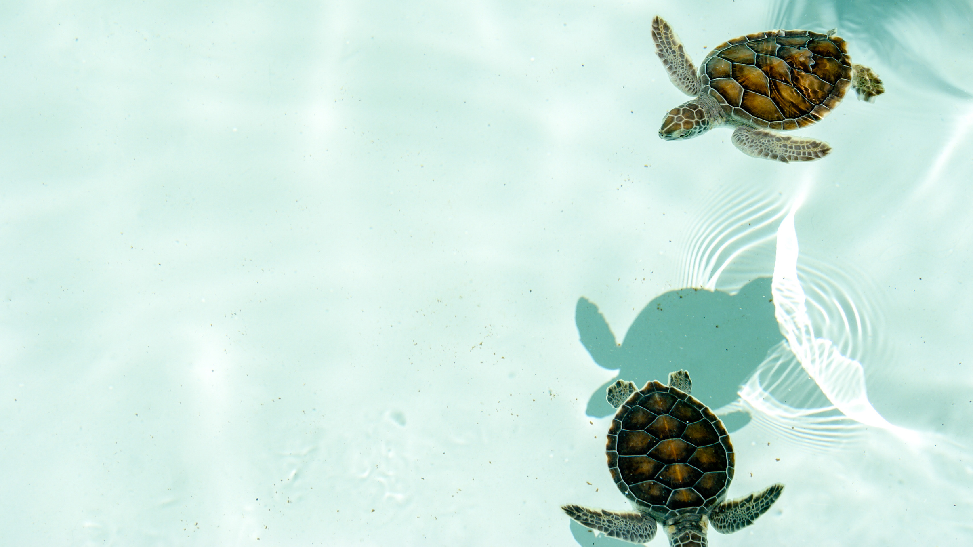
THANK YOU
Contribution:
Aryan Kumar (190185) - 20%- Worked on making all the presentations & report and helped with the researching & connections.
Naveen Kumar Mathur - 20% - Worked on establishing connections with Rpi, encryption-decryption and socket programming
Amit Kumar Singh (190117) - 20% - Worked on connection and functioning of sensors & led, serial communication between boards, socket communication and web page.
Prince Kumar Ahirwar(190646) - 20%- working of solenoid valve and connections with arduino uno device.
Aman Raw (190108) - 20% -worked on connections of raspberry pi and sending data from sensor to laptop.

